Slide 1

Induction Ceremony
Νορτη Χαρολινα Ζετα
North Carolina Zeta

Slide 2
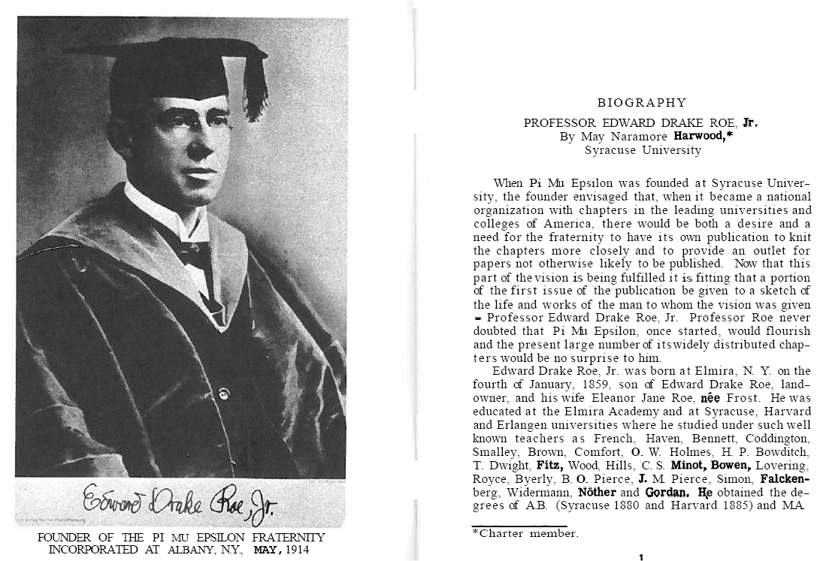
History

Slide 3


Slide 4
NC Chapters
Α | α | Alpha
Β | β | Beta
Γ | γ | Gamma
Δ | δ | Delta
Ε | ε | Epsilon
Ζ | ζ | Zeta
Η | η | Eta
Θ | θ | Theta
Ι | ι | Iota
Κ | κ | Kappa
Λ | λ | Lambda
Μ | μ | Mu
Ν | ν | Nu
Ξ | ξ | Xi
Ο | ο | Omicron
Π | π | Pi
Ρ | ρ | Rho
Σ | σ | Sigma
Τ | τ | Tau
Υ | υ | Upsilon
Φ | φ | Phi
Χ | χ | Chi
Ψ | ψ | Psi
Ω | ω | Omega
North Carolina Alpha (24 - 1932) Duke University Durham, NC 27708 | North Carolina Beta (46 - 1948) University of North Carolina at Chapel Hill Chapel Hill, NC 27599
North Carolina Gamma (77 - 1960) North Carolina State University Raleigh, NC 27695-8205 | North Carolina Delta (135 - 1968) East Carolina University Greenville, NC 27858
North Carolina Epsilon (147 - 1969) University of North Carolina at Greensboro Greensboro, NC 27412 | North Carolina Zeta (186 - 1974) University of North Carolina at Wilmington Wilmington, NC 28403
North Carolina Eta (200 - 1976) Appalachian State University Boone, North Carolina 28608 | North Carolina Theta (205 - 1977) University of North Carolina at Charlotte Charlotte, NC 28223
North Carolina Iota (223 - 1979) North Carolina Central University Durham, North Carolina 27707 | North Carolina Kappa (228 - 1981) North Carolina A & T State University Greensboro, N. C. 27411
North Carolina Lambda (242 - 1984) Wake Forest University Winston-Salem, NC 27109 | North Carolina Mu (258 - 1989) Meredith College Raleigh, NC 27607
North Carolina Nu (307 - 2003) Elon University, Elon, NC 27244

Slide 5
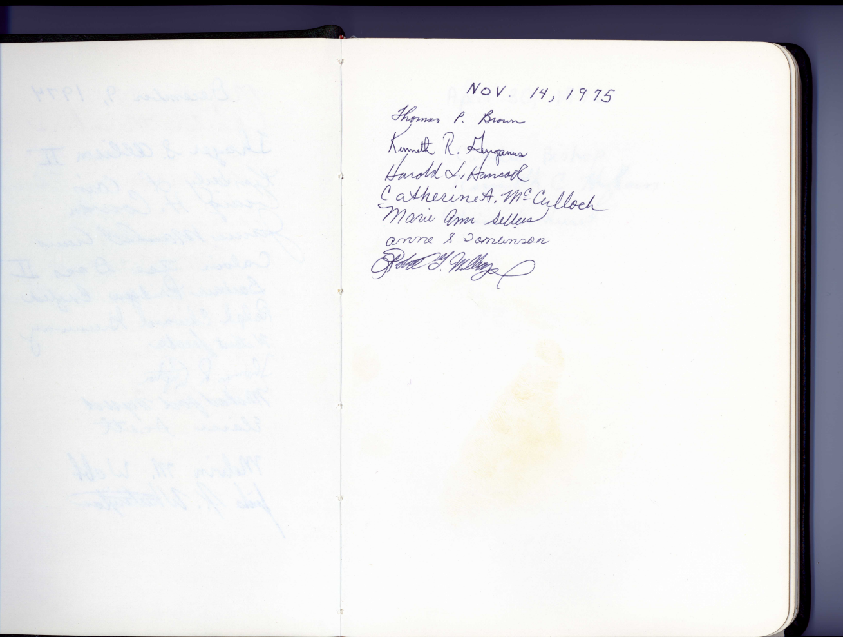
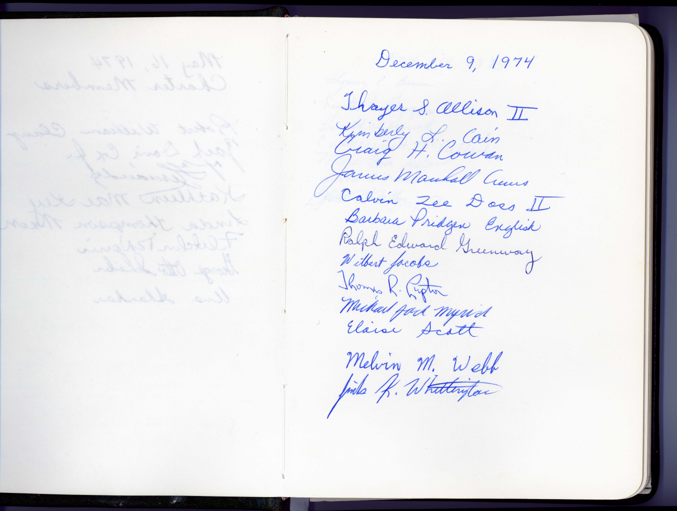
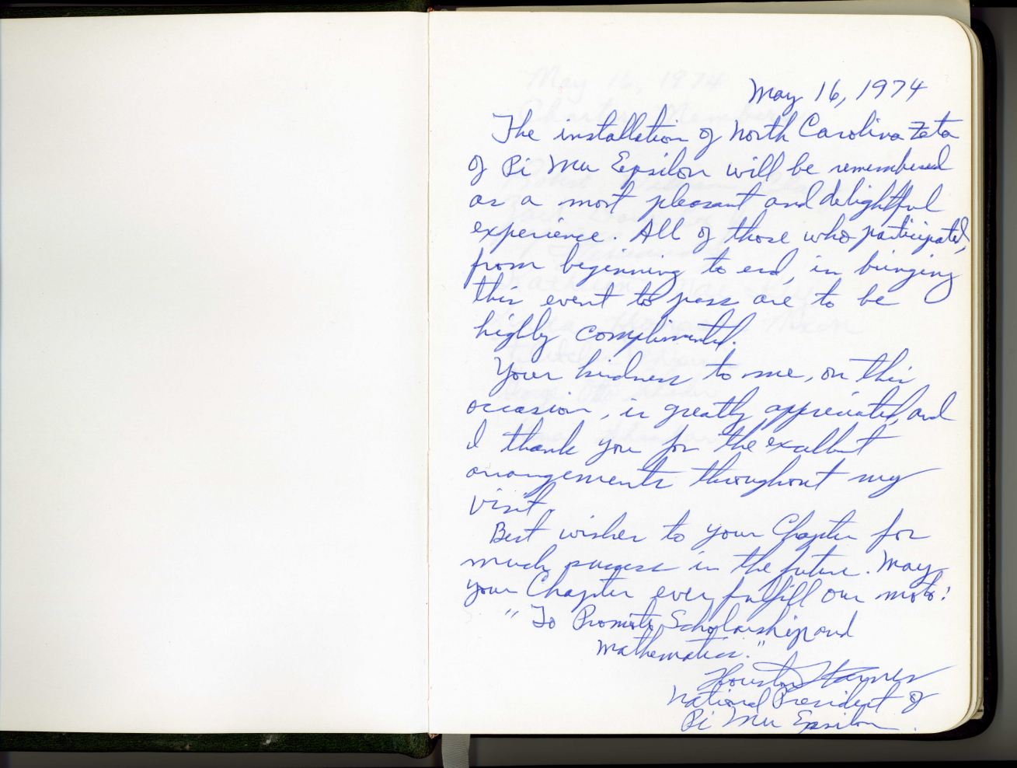
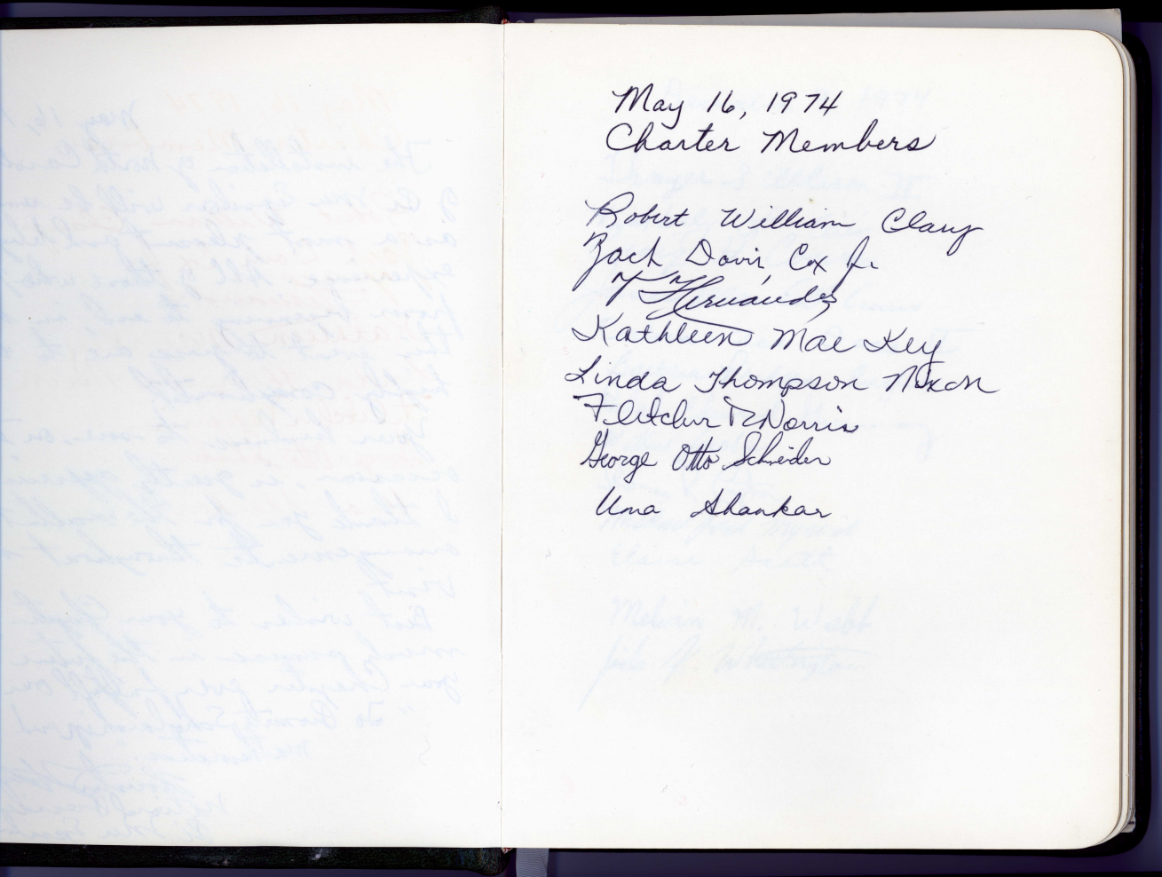
NC Zeta – Roll Book

Slide 6
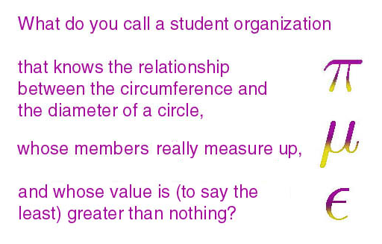
Pledge
From SUNY Potsdam
"I solemnly promise that I will exert my best efforts to promote true scholarship, particularly in mathematics; and that I will support the objectives of the Pi Mu Epsilon Honor Society."

Slide 7
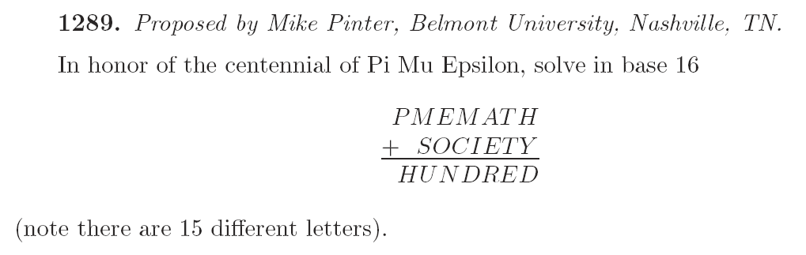
Inductees
Come up as you are called …
Richard Ogden
William Prince
Ilona Reding
Kaela Vogel
Erik Willis
Amanda Bowen
Andrea Dickens
Troy Kling
Christopher Mendenhall
Kristen Moody

Slide 8

CREST & LOGO
Ten
To
Paedeusin
education
Kai
and
Ta
to
Mathematica
mathematics
Epispeudein
promote
ΠΜΕ την Παιδενσιν και τα Μαθηματικα Επισπεϖδειϖ

Slide 9
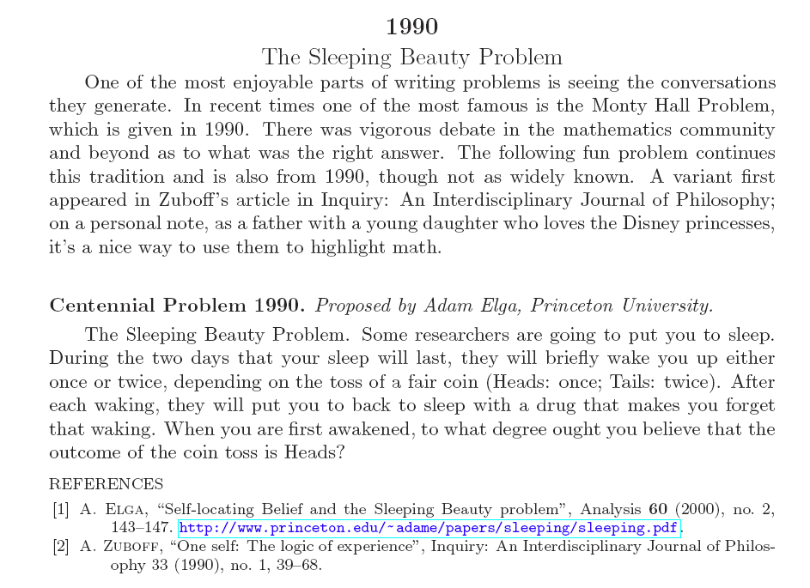
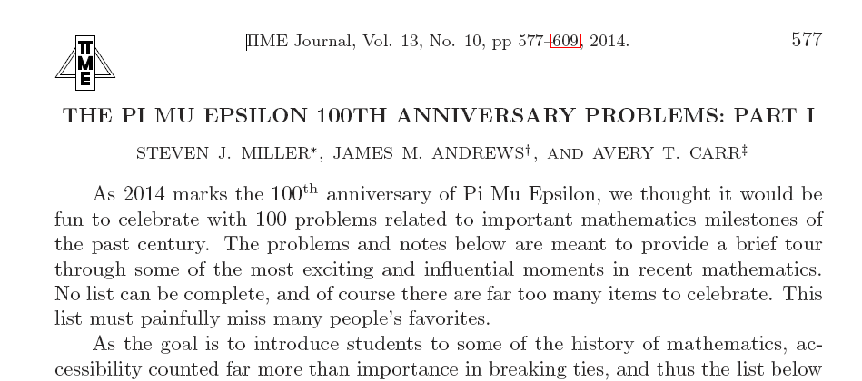
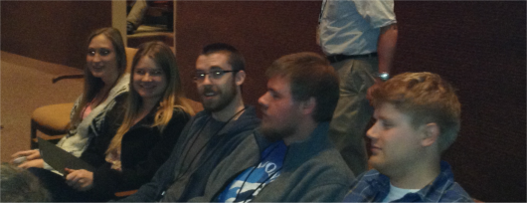
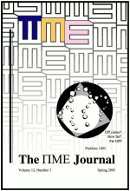
National Activities
Pi Mu Epsilon Journal
MAA Meetings
Supported by Pi Mu Epsilon for speaking, delegates, …
Mathfest – Portland, OR August 2014
MAA Southeastern Section – Wilmington, 2015

Slide 10
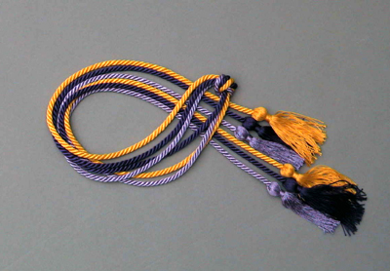
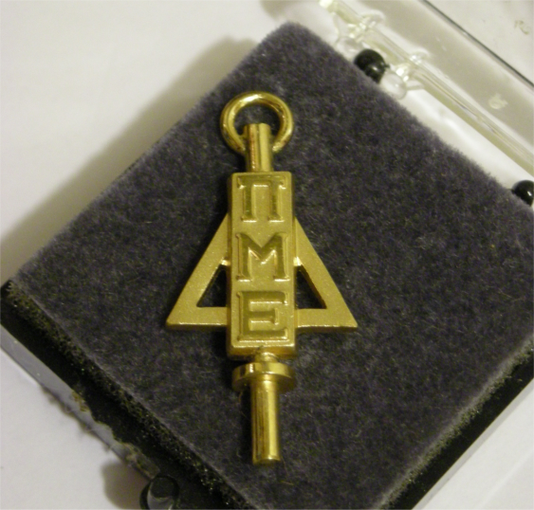
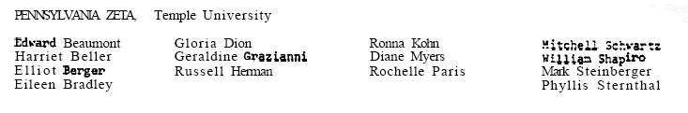
Honor Chords and Pin

Slide 11

Congratulations
Amanda Bowen
Andrea Dickens
Troy Kling
Christopher Mendenhall
Kristen Moody
Richard Ogden
William Prince
Ilona Reding
Kaela Vogel
Erik Willis

