Slide 1

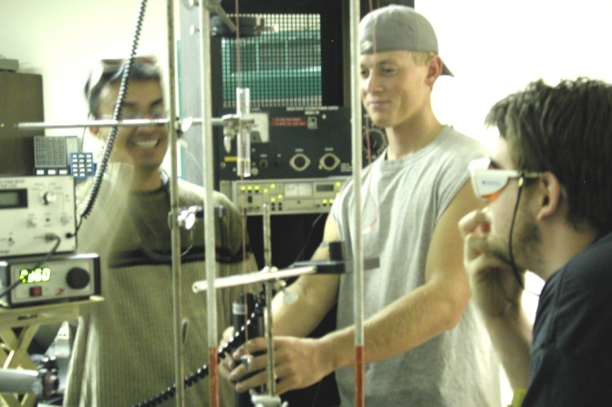
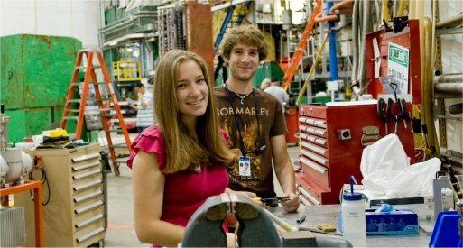
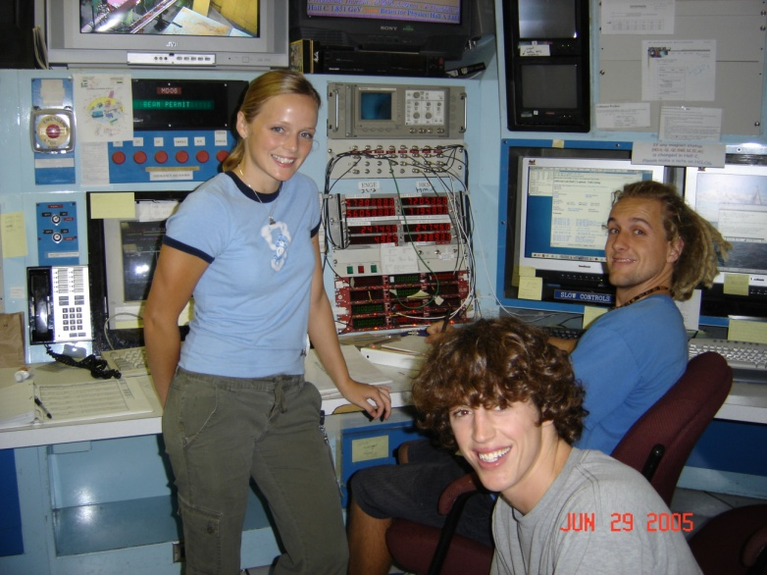
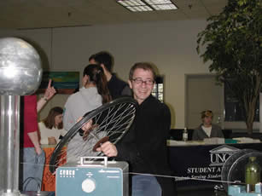
What is physics?
Why major in physics?
What is physical oceanography?
What can you do with a physics degree?

Slide 2
Program
Why Would I Major in Physics?
Introduction to the Faculty & Staff
What is Physics?
Physics Requirements
What is Physical Oceanography?
Undergraduate Experiences
What Can I Do With a Physics Degree?
Physics Demonstration

Slide 3
Why Would I Major in Physics?
It's interesting and exciting!
It's a versatile major.
  A major in physics is a way to keep your options open.
Achieve deeper understanding.
  The physicist's approach to problem solving is to first understand the problem and the concepts.
Smaller class size.
The Physics reputation.
  Physics majors have a reputation for solid mathematical skills, strong problem solving ability.
Good Salaries!
  Physics majors are near the top in terms of average salary.

Slide 4












Faculty & Staff
Dr. Bingham
Dr. Olszewski
Dr. Herman
Ms. Bonnie Mattis
Dr. Gan
Dr. McNamara
Dr. Black
Dr. Davis
Dr. Alexanian
Ms. Yvonne Marsan
Dr. Morrison
Dr. Moyer

Slide 5
Areas of Specialization
Atomic Physics
Charge exchange in atomic collisions; response of atoms to intense electro-magnetic fields; atomic structure studies; autoionization. Professors Alexanian, Davis, Moyer
Marine Sciences
Physical oceanography; general ocean circulation; air-sea interaction and climate; global distributions of sea surface salinity; ocean observing systems; coastal fluid dynamics and large-scale coastal morphology; coral reef ecology. Professors Bingham, McNamara, Morrison, Moss
Mathematical Physics
Nonlinear wave equations; complexity theory and chaos; coupled human-environmental dynamical systems; general relativity; geometric methods for pde's; numerical analysis; generalized transforms. Professors Herman, McNamara
Nuclear and Particle Physics
Low energy few-nucleon systems; hypernuclear physics; quantum chromo-dynamics; string theory.
Professors Black, Gan, Olszewski
Physics Education
Instructional technology; general physics pedagogy. Professors Black, Herman, Moyer

Slide 6
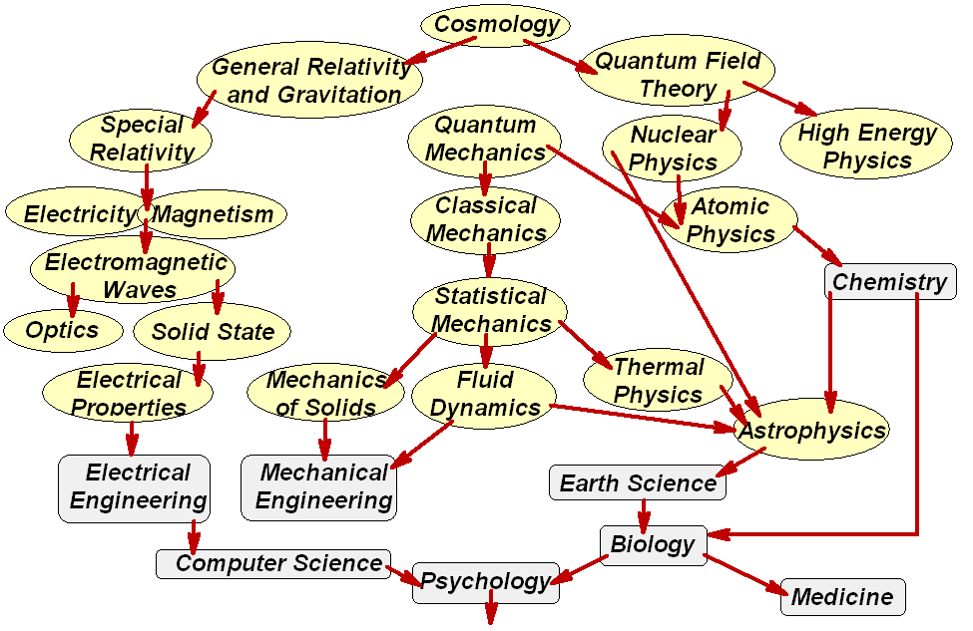
What is Physics?
Physics encompasses the study of the universe
from the largest galaxies to the smallest subatomic particles.

Slide 7
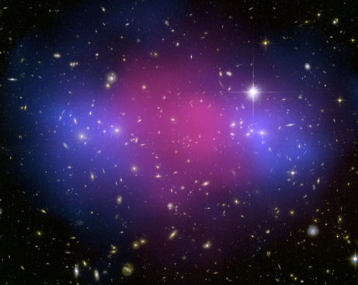
Physics is Exciting!
Discoveries from physics have
revolutionized the world.
intriguing topics
  lasers, superconductors,
  black holes,
  quantum mechanics,
  big bang theory, relativity, …
fascinating topics
  why the sky is blue,
  why sunsets are red,
  why ice floats.
Physicists are explorers trying to understand the world around them.
From American Institute of Physics (AIP)
  The majority of students major in physics for shear enjoyment
  86% of the alumni report that they would major in physics again if they had it to do over.

Slide 8
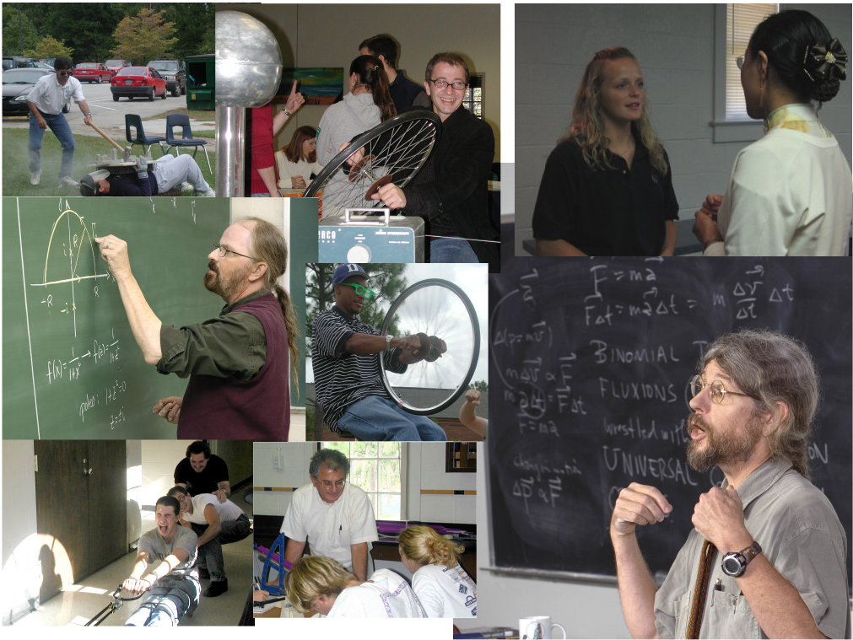
Challenging Courses
Classical Dynamics
Electricity and Magnetism
Physical Oceanography
Quantum Mechanics
Electronics
Optics
Astronomy
Chaos & Complexity
Archeoastronomy
General Relativity
High Energy Physics
Cosmology

Slide 9
Physics Requirements
Requirements for a Major in Physics for the B.A. Degree: 46 hours. PHY 201-202, 260, 300, 321, 335, plus 6 hours of physics course electives at the 300-400 level; CHM 101-102; MAT 161-162 and 261.
Requirements for a Major in Physics for the B.S. Degree: PHY 201-202, 311, 321, 335, 411, 444, 455, and 495; CHM 101- 102; MAT 161-162, 261, and 361; These core courses must be supplemented with one of the following options to fulfill the degree requirements.
Option 1. General Physics. 66 hours. Core requirements plus PHY 300, 322, 400, and 412; MAT 335.
Option 2. Physical Oceanography. 72 hours. Core requirements plus PHY 315, 350, 475, 477, 481 and 1 course chosen from PHY 478, 479, 480; and GLY 150.

Slide 10
Other Options
Requirements for Teacher Licensure:
Students who plan to become licensed teachers in the North Carolina public schools must complete the university’s Basic Studies expectations, all requirements in the major, and be formally admitted to the Watson School of Education. Requirements for admission are listed in the UNCW Undergraduate Catalogue.
Requirements for a Minor in Physics: 18 hours. PHY 201-202, 335 and 6 additional hours in physics, not to include PHY 101, 102, or 105; at least 3 of these additional hours must be at the 300-400 level. A grade of "C" or better is required in each physics course counted toward the minor.
Requirements for a Minor in Physical Oceanography: 21 hours. PHY 201-201, 475, 477, 481 and 1 additional course from PHY 315, 350, 478, 479, 480. GLY 150. A grade of “C” or better is required in each physics course counted toward the minor.

Slide 11
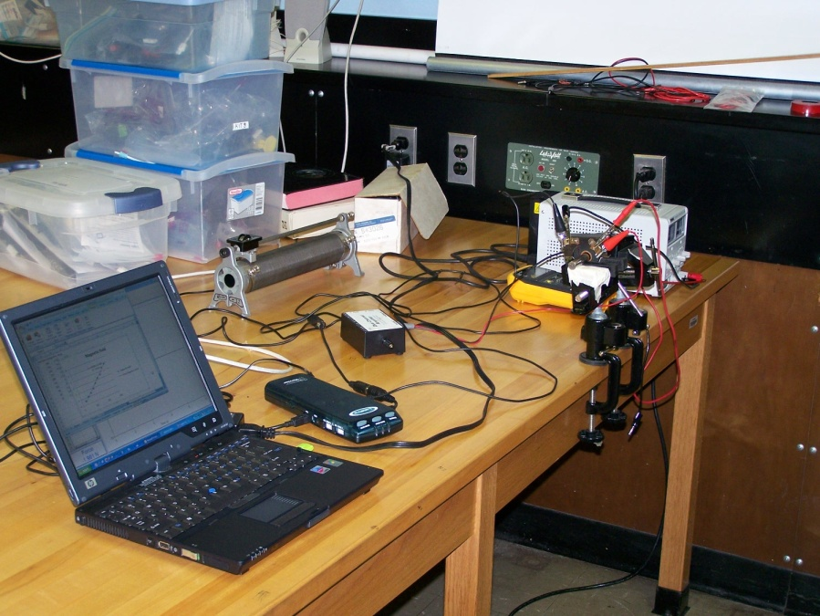
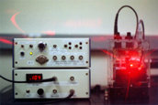
Electrical Engineering
Earn UNCW & NCSU Degrees in 5 years
Combining physics at UNC Wilmington with electrical engineering at North Carolina State University gives students the option to earn a bachelor of science in physics from UNC Wilmington and a bachelor of science in electrical engineering from NCSU.
UNC Wilmington phase of study can be completed in three years. Students meeting applicable transfer admission requirements are accepted to NCSU’s Electrical Engineering Program, which can be completed in two years.

Slide 12
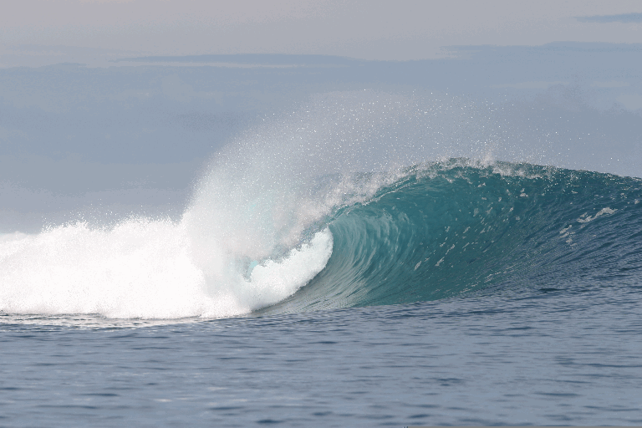
What is Physical Oceanography?
… the study of physical conditions and processes within the ocean.
Nationally there is a critical need for physical oceanographers.
  July 19, 2010, the President established the first National Policy for Stewardship of our Oceans, Coasts, and Great Lakes
  recommends increasing our education about the ocean, our coasts, and the Great Lakes
The Bureau of Labor projects
  employment of geophysicists and oceanographers expected to grow 18%, faster over next decade!
Dr. McNamara …

Slide 13
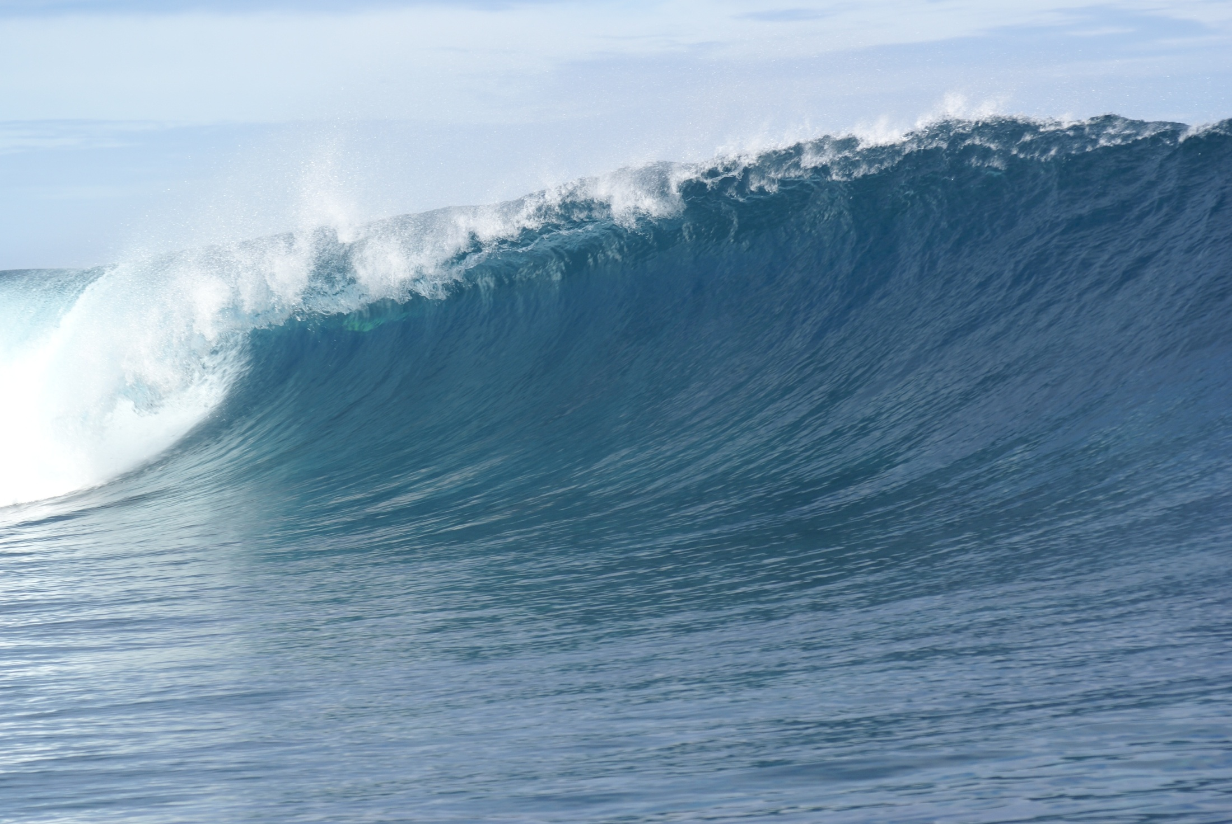
Physical Oceanography
The physics of the ocean (large-scale ocean currents, waves, tides,
ocean atmos interactions)
Can go to grad school in physical oceanography, climate, geophysics,
ocean engineering, coupled bio-physical oceanography, etc…

Slide 14
Physical Oceanography
CMS Video
UNCW/CMS opportunities
  CMS fellowship
  Southampton Exchange
  Summer Research
  Conferences
Dr McNamara (beach physics, surf zone fluid dynamics, complexity)
Dr. Morrison (ocean circulation, ocean observing systems, climate)
Dr. Bingham (global salinity distribution, regional oceanography)

Slide 15
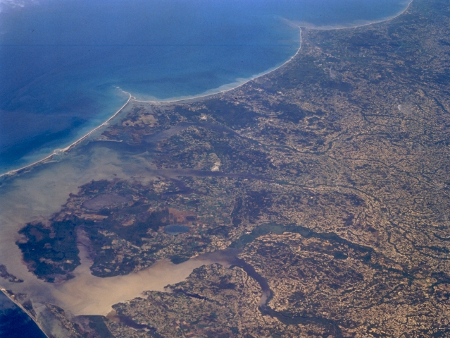
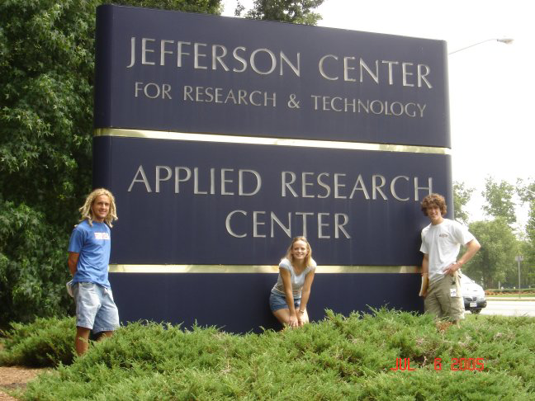

Undergraduate Experiences
Zach Williams
Anthony Tatum

Slide 16




Student Groups

Slide 17
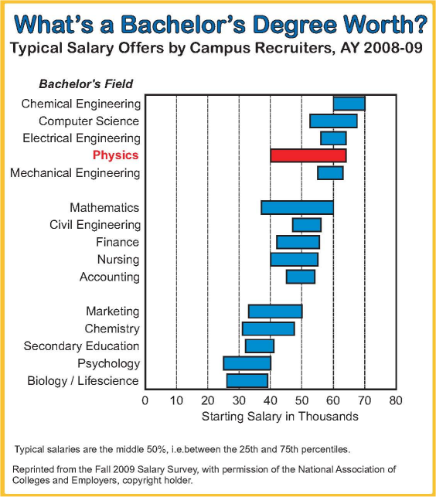
What Can I Do With A Physics Degree?
Physics graduates don't always do physics.
The most marketable skills
  analytical &problem solving skills.
  High MCAT, LSAT scores
Careers in
  engineering,
  business, management,
  finance,
  law , patent law
  computer science,
  medicine, bio-physics
  Military
Graduate School

Slide 18
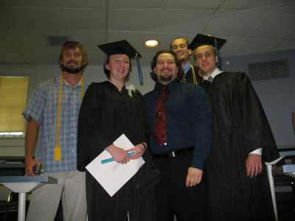
Immediate Plans After Graduation
UNCW Physics Graduates 2001-2009
Recent Graduate Programs:
UNCW – Marine Science
U. Maryland BC – chemical physics
U. Texas, Arlington –
U. Texas, Houston – neurophysics
UNC Chapel Hill – physics
NC State – physics, food science
U. Colorado, Boulder – solar energy

Slide 19
Take Home Messages
It's interesting and exciting!
It's a versatile major.
Achieve deeper understanding and problem solving skills
Small department:
  small classes,
  know faculty and students.
The Physics reputation.
Good Salaries!
Alumni glad they majored in physics
Physical oceanographers are needed
Take PHY 201, MAT 161 early
See Dr. Herman for more info

Slide 20
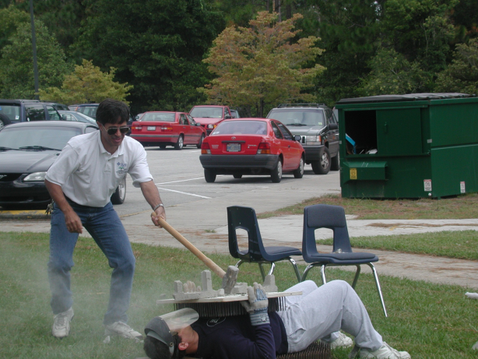

Physics Demonstration

