Slide 1
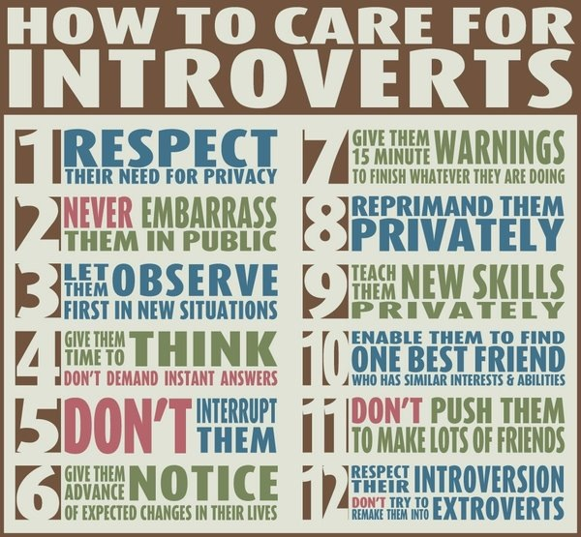
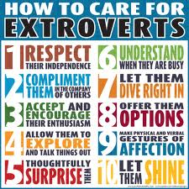
Engaging introverts in the classroom
Lisa Buchanan, Marsha Carr, and Russell Herman

Slide 2

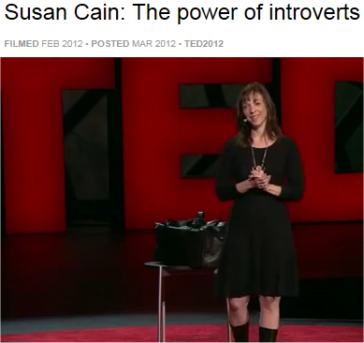

Quiet
The Power of Introvert in a World That Can’t Stop Talking, by Susan Cain
http://www.ted.com/talks/susan_cain_the_power_of_introverts.html
http://www.thepowerofintroverts.com/

Slide 3
Would you know one if you saw one?
Abraham Lincoln, Eleanor Roosevelt, Rosa Parks,
Marcel Proust, Frédéric Chopin, Charles Darwin,
Mother Teresa, Gandhi , Dale Carnegie,
Steven Spielberg, J.K. Rowling, Charles Schulz,
Barack Obama, Mitt Romney, Ron Paul,
Albert Einstein, Dr. Seuss, George Orwell,
Warren Buffett, Al Gore, J. M. Barrie ,
Larry Page, Bill Gates, Steve Wozniak,
Charles Schwab, David Letterman, Barbara Walters,
Isaac Newton, Pablo Picasso, W. B. Yeats

Slide 4
Myths
Introverts
Are shy.
Do not like people.
Don’t like to go out in public.
Always want to be alone.
Don’t know how to have fun.
Are weird and aloof nerds.
Can fix themselves
… and become extroverts.
… ???
http://www.stumbleupon.com/su/2Rq4SN/jerrybrito.org/post/6114304704/top-ten-myths-about-introverts

Slide 5
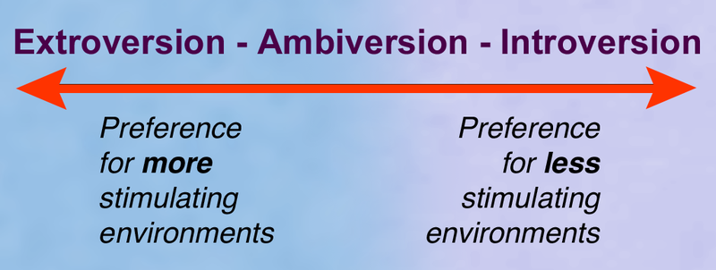
Quiz- Are you and introvert or an extrovert?
I prefer one-on-one conversations to group activities.
I often prefer to express myself in writing.
I enjoy solitude.
I seem to care less than my peers about wealth, fame, and status.
I dislike small talk, but I enjoy talking in depth about topics that matter to me.
People tell me that I'm a good listener.
I'm not a big risk taker.
I enjoy work that allows me to "dive in" with few interruptions.
I like to celebrate birthdays on a small scale, with only one or two close friends or family members.
People describe me as "soft-spoken" or "mellow."

Slide 6
Quiz- Are you and introvert or an extrovert?
I prefer not to show or discuss my work with others until it's finished.
I dislike conflict.
I do my best work on my own.
I tend to think before I speak.
I feel drained after being out and about, even if I’ve enjoyed myself.
I often let calls go through to voice-mail.
If I had to chose, I’d prefer a weekend with absolutely nothing to do to one with too many things scheduled.
I don’t enjoy multitasking.
I can concentrate easily.
In classroom situations, I prefer lectures to seminars.

Slide 7
“Screening Out the Introverts”
http://chronicle.com/article/Screening-Out-the-Introverts/131520/ - The Chronicle of Higher Education, (2012), William Pannapacker
“Not one student had received an "I" for introversion. Everyone, it seemed, was an extrovert (Myers-Briggs spells it with an "a," like "extra"). Everyone but me.”
“Extroverts … are oriented outward, toward other people and toward action over reflection. They draw energy from social interaction, and they tend to be outspoken and gregarious.”
“Introverts … are oriented toward the inner life of thought; they tend to be reserved and cautious. They find social interactions draining, and they need solitude to recharge. … They don't like small talk but appreciate deeper discussions.”
“the test might as well have asked, ‘Would you prefer to be cool, popular, and successful or weird, isolated, and a failure?’”

Slide 8
Comments/Questions
Western Culture has a long history of privileging extroversion
Western vs Asian cultural ideals (speaking less and thinking more)
Introversion affects business, religion, education, parenting, …
Studies indicating biological wiring
Seminars at the Harvard Business School:
students expected to leap into discussions, hold the spotlight, regardless of whether they have anything to add to the conversation.
20th century emphasis on personality:
selling oneself: being a "mighty likeable fellow.“
culture of shallow thinking, compulsory optimism, risk-taking in pursuit of success
Extroverts responsible for the economic crisis?
Introverts and Extroverts in Academics – Students/Faculty
Students
How do we recognize introverts/extroverts and adapt our teaching?
Faculty
A refuge from the social demands of other careers?
Attend countless social/networking events that introverts find exhausting?
How do we assess faculty?
Graduate Students/New Faculty teaching for the first time
Are they worried about how introversion translates into the classroom?

Slide 9
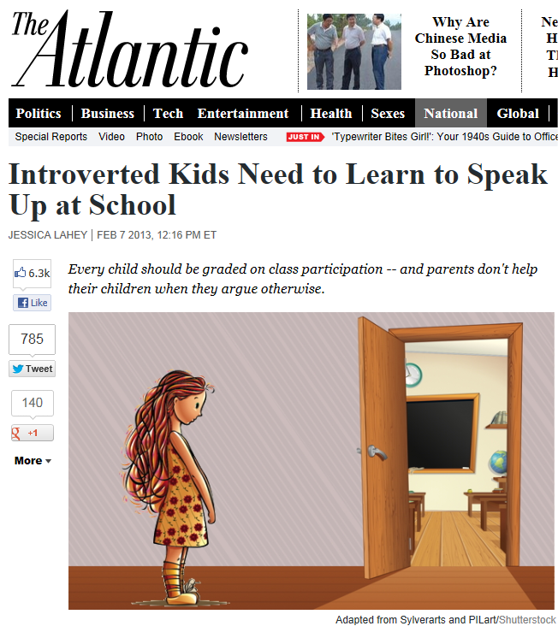

Discuss …

