Slide 1
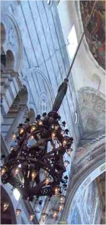
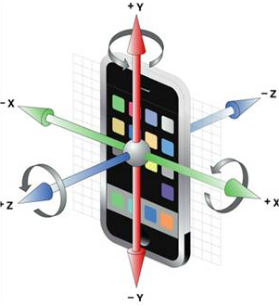
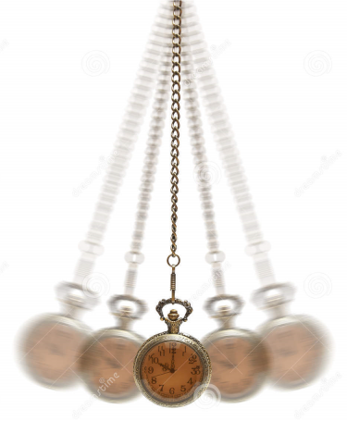
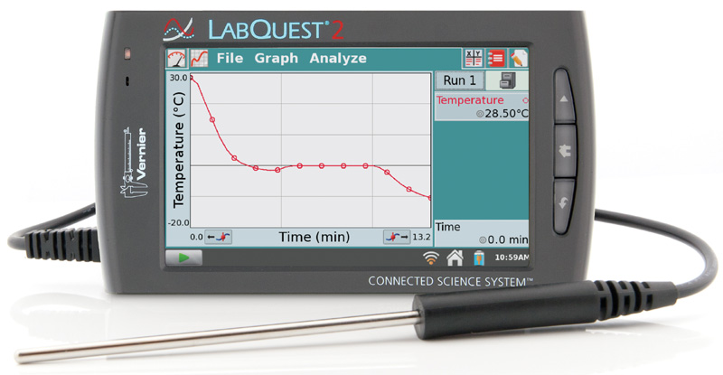
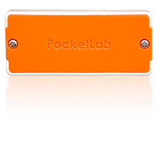
Sensor Overload for iSTEM
Experimental Design, Collection,
Graphing, and Analysis of Data
Dr. Russell Herman, UNCW
Physics & Physical Oceanography
Mathematics & Statistics

Slide 2
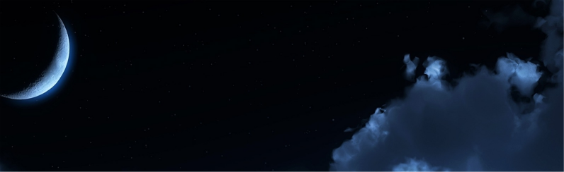
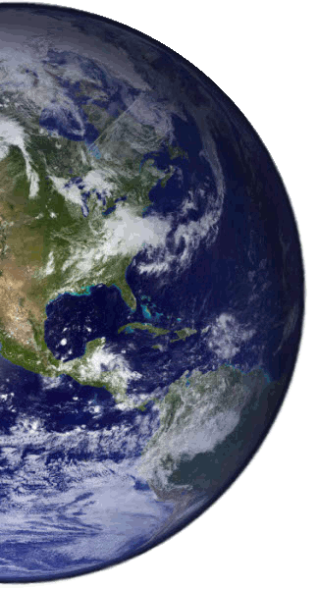
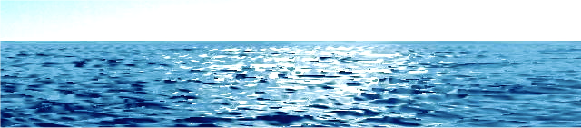
Experiments
Design
Data Collection
Graphics
Analysis

Slide 3
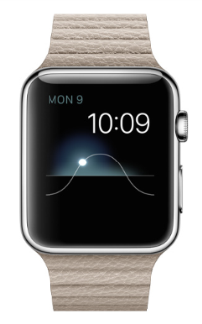
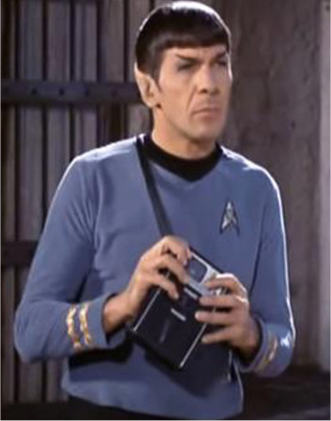
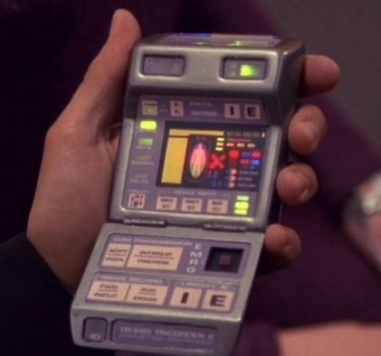
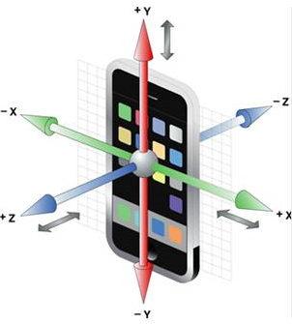
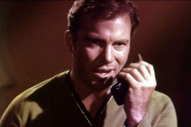
Sensors
Camera
Audio
Accelerometer
Gyroscope
Geomagnetic
GPS …

Slide 4
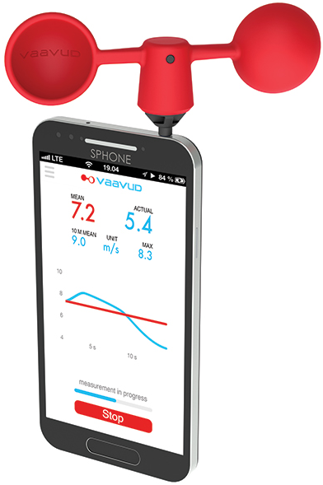
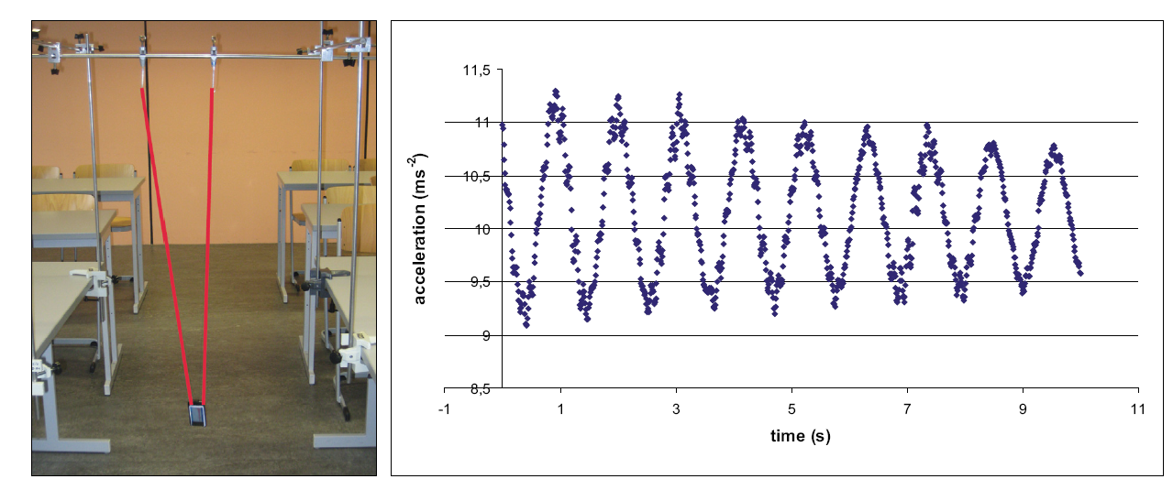
Sample STEM Experiments
Kinematics, Forces, Rotational Acceleration
Photometer
Magnetic fields
Sound Levels
Temperature
http://dx.doi.org/10.1119/1.4752056

Slide 5
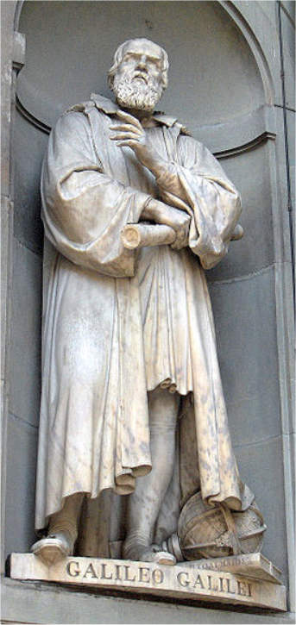
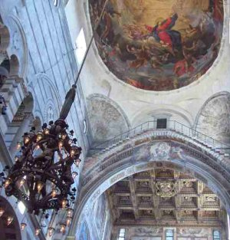
Galileo’s Lamp
Dome of the Cathedral of Pisa
What is the period of oscillation?
Independent of initial angle.
http://en.wikipedia.org/wiki/Galileo_Galilei

Slide 6
Make a Measurement - Data

Slide 7
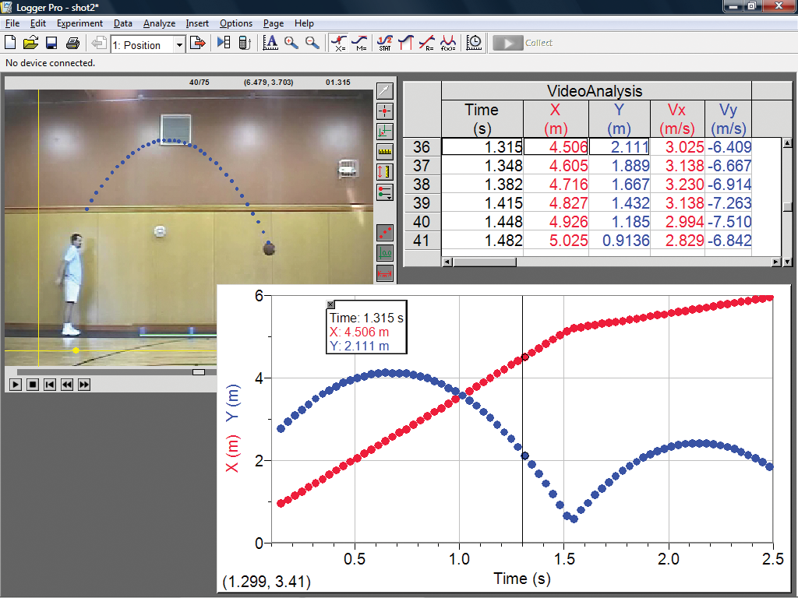
Data Acquisition
Data Collection
  Probes
  Images
  Video
Interfaces
  Vernier
    Logger Pro
    Lab Quest
  Pasco
    Capstone

Slide 8
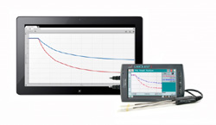
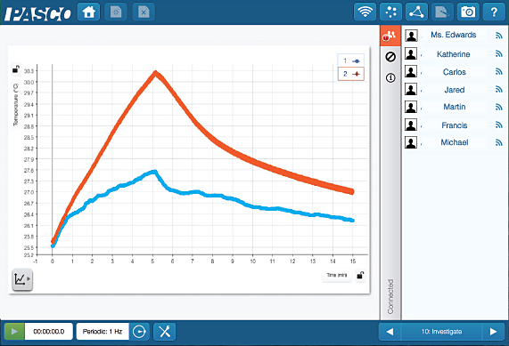
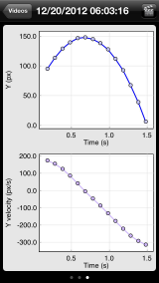
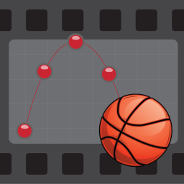
Mobile Apps
Pasco
  SPARKVue
Vernier
  Graphical Analysis
  Video Physics
Other
  Tracker
  Video Analysis
  at Ball State

Slide 9
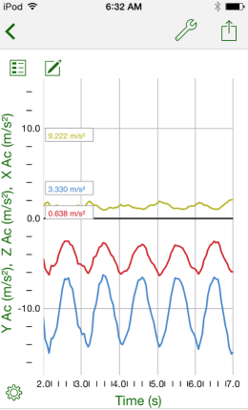
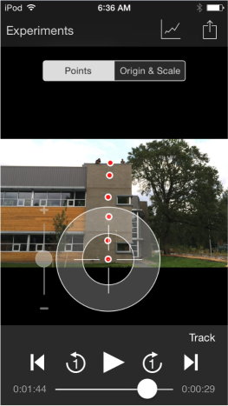
Examples
Pendulum Video tracking

Slide 10
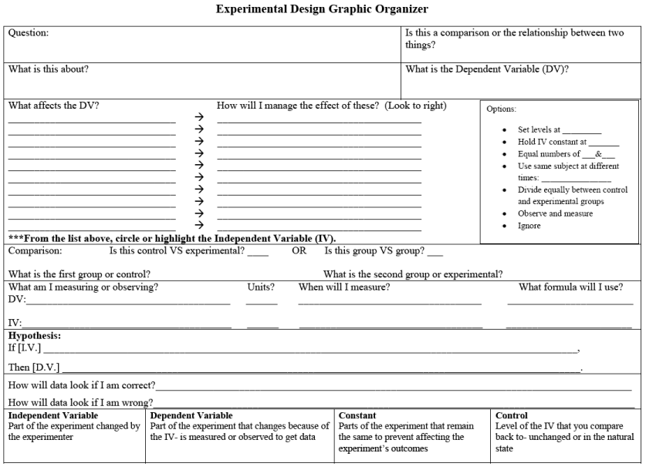
Experimental Design
LEARN NC, UNC School of Education

Slide 11
Summary
Sensors
Data Acquisition
Data Analysis
Experimental Design

Slide 12
Analysis Tools
Open Source Software
  MATLAB – Gnu Octave
  Maple – Maxima/Sage Math
  MS Excel – Open Office
  Python – Scipy, Matlib, Numpy, Vpython

